Slide 1
Digital image processing and analysis 3. Colour: physical origins, perception and characterisation
Professor Ela Claridge
School of Computer Science

Slide 2
Previous lecture:
Digital image properties
Computer representation – pixels
Sampling – related to image coordinates
Quantisation – related to image values
… and how they relate to image acquisition

Slide 3
In this lecture we shall find out about:
Colours and their origins
Physical underpinnings
Human visual perception
Colour images
Image acquisition
Colour spaces

Slide 4
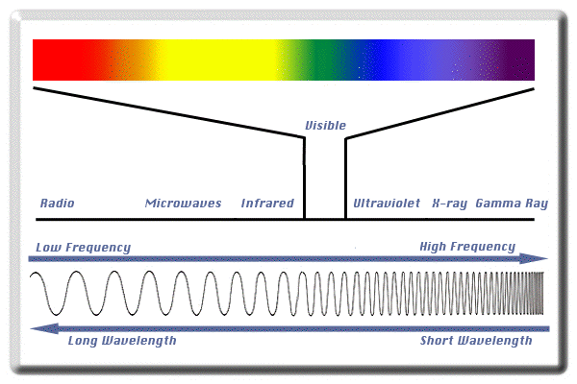
What is colour Physical underpinnings
Light – a part of electromagnetic spectrum

Slide 5
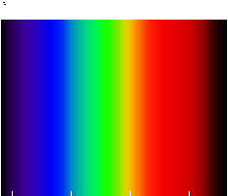
What is colour Physical underpinnings
Colour spectrum – visible light
Ultraviolet
Infrared
Wavelength
400 nm
700 nm

Slide 6
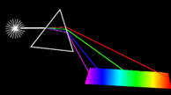
What is colour Physical underpinnings
Newton’s experiment
Conclusion:
“White” light is a combinations of many different light wavelengths

Slide 7
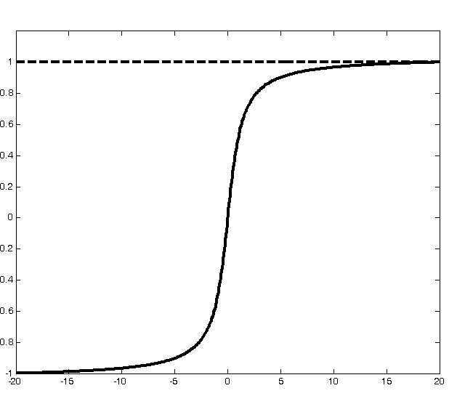
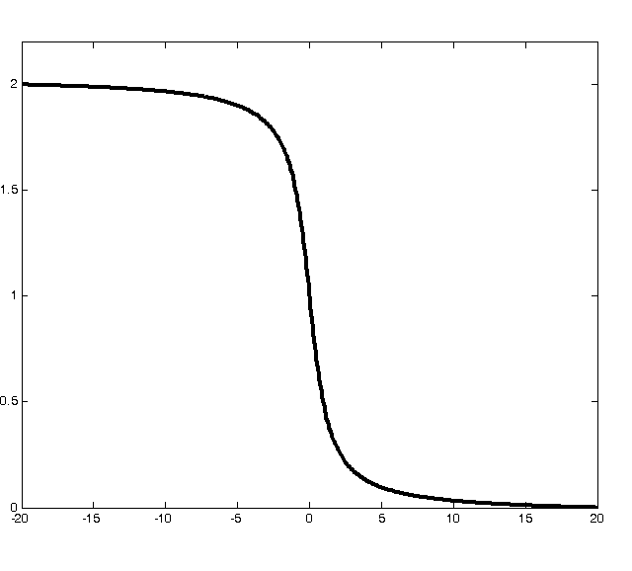
What is colour Physical underpinnings
Spectrum of white light
Surface absorption
spectrum
Surface reflectance spectrum

Slide 8
What is colour Physical underpinnings
Spectrum of white light
Surface reflectance spectrum
Surface absorption
spectrum
White light is a mixture of all wavelengths, at equal magnitudes
Object absorbs certain parts of the spectrum and reflects the remaining parts.

Slide 9
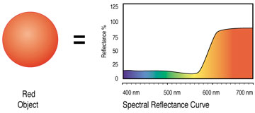

What is colour Physical underpinnings
We see/image light reflected from surfaces
Absorbed light spectrum
Absorption curve
Red object
Reflected light spectrum
White light
White light is a mixture of all wavelengths, at equal magnitudes

Slide 10
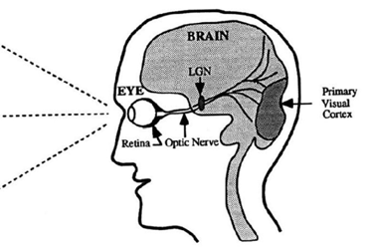
What is colour Sensing
The eye and the brain
Sensor
(retina)
Pupil
(aperture)
Lens

Slide 11
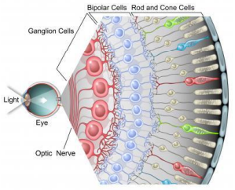
What is colour Sensing
Retina
Cones
detect detail and colour, central, 6 million
Rods
sensitive to light & motion, off-centre, 120 million
Fovea
densely packed with cones, fine detail,
uniform resolution

Slide 12
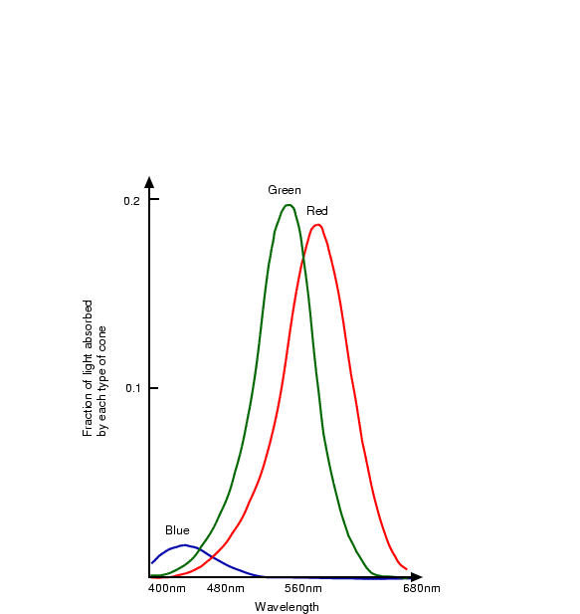
What is colour Sensing
Colour (spectral) sensitivity of the cones
Green
Red
Blue

Slide 13
What is colour Sensing
Colour is a percept
White is a colour, the perception which is evoked by light that stimulates all three types of colour sensitive cone cells in the human eye in nearly equal amounts and with high brightness. [Wikipedia]
Red is a colour, the perception of which is evoked by light that stimulates “red” sensitive cones in the human eye, and no other cones (“green” or “blue”)
Colour is not a physical phenomenon

Slide 14
What is colour Sensing
Colour vision deficiency (colour blindness)
The decreased ability to see colour or differences in colour.
Caused by a deficiency one or more of the three sets of color sensing cones in the eye.
Typical perception
Deficient perception
[Source: Wikipedia]

Slide 15
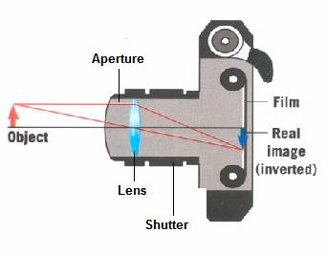
Colour images Acquisition
Sensor
(retina)
Sensor
(CCD, CMOS)
Pupil
(aperture)
Lens

Slide 16
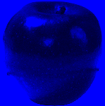
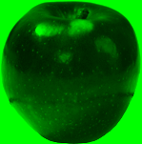
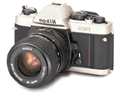
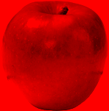
Colour images Acquisition
Acquisition
Primary colours tutorial http://micro.magnet.fsu.edu/primer/lightandcolor/primaryhome.html

Slide 17

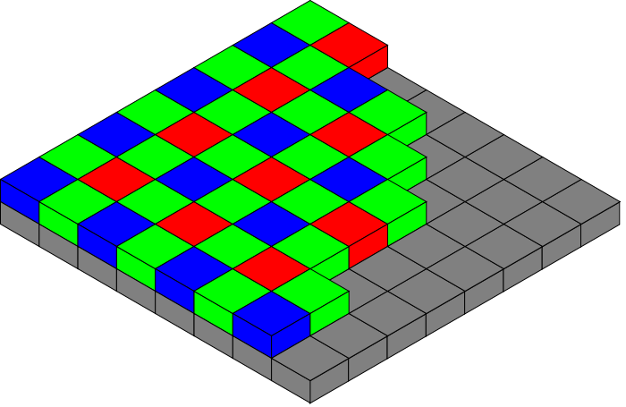

Colour images Acquisition
Bayer filter
Image mosaic
Interpolated final image

Slide 18
Colour images Acquisition
Bayer filter
255 | 127 | 255 | 127
255 | 255 | 255 | 255
255 | 127 | 255 | 127
0 | 255 | 0 | 255
 | R:127 G:255 B:255
Average red = 127
Average green = 255
Average blue = 255
Image mosaic
Interpolated final pixels

Slide 19
Colour images Acquisition
Bayer filter
255 | 127 | 255 | 127
255 | 255 | 255 | 255
255 | 127 | 255 | 127
0 | 255 | 0 | 255
 |  | R:127 G:255 B:127
Average red = 127
Average green = 255
Average blue = 127
Image mosaic
Interpolated final pixels

Slide 20
Colour images Acquisition
Bayer filter
255 | 127 | 255 | 127
255 | 255 | 255 | 255
255 | 127 | 255 | 127
0 | 255 | 0 | 255
 | R:127 G:255 B:255 | R:127 G:255 B:255
 | R:127 G:255 B:127 | R:127 G:255 B:127
Image mosaic
Interpolated final pixels

Slide 21
Colour images Acquisition
Bayer filter
255 | 255 | 255 | 255
255 | 255 | 255 | 255
255 | 255 | 255 | 255
255 | 255 | 255 | 255
 | R:255 G:255 B:255 | R:255 G:255 B:255
 | R:255 G:255 B:255 | R:255 G:255 B:255
Image mosaic
Interpolated final pixels

Slide 22
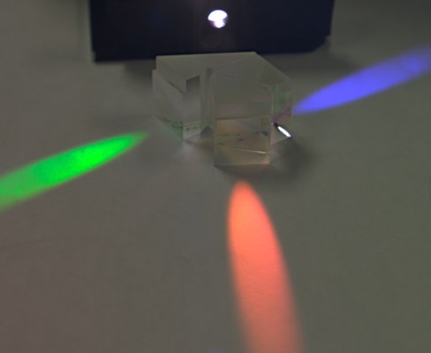
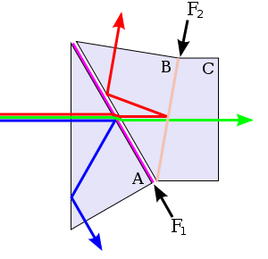
Colour images Acquisition
Three-CCD (3CCD)
Prisms

Slide 23
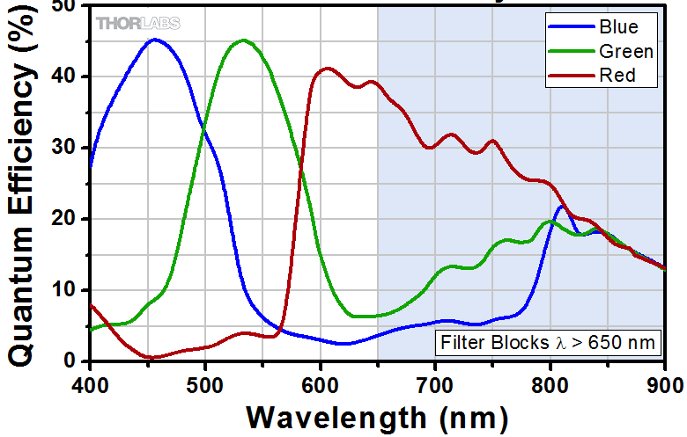
Colour images Acquisition
Spectral sensitivity of a typical CMOS sensor
Spectral sensitivity of the cones

Slide 24
Colour spaces
A colour space represents a system for measuring colours
Most colours can be represented using three colour components
They are called the primary colours (or the primaries)

Slide 25
Colour spaces
There are many colour spaces.
The choice of a particular space depends on the context in which we want to describe colours. The four most common colour spaces are:
RGB
HSV
CMY (K)
XYZ

Slide 26
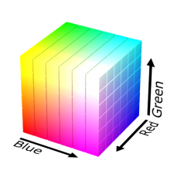
Colour spaces RGB
Primaries: Red - Green - Blue
Similar to colours detected by colour receptors in the eye
Used in display technology
Green
Cyan
White
Yellow
Black
Blue
Red
Magenta

Slide 27
Colour spaces RGB

Slide 28
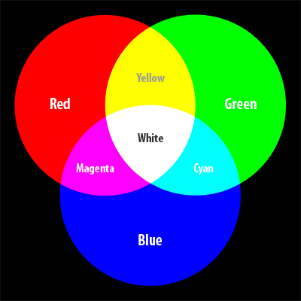
Colour spaces RGB
Mixing is additive
Image source: http://www.netsourceinc.com/blog/quick-color-guide

Slide 29
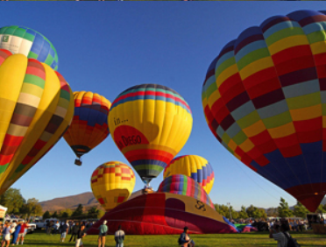
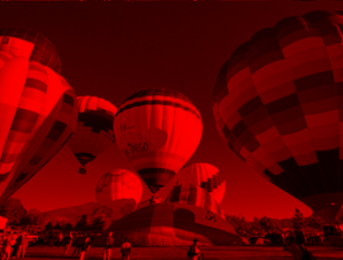
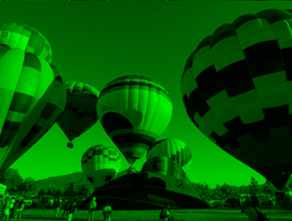
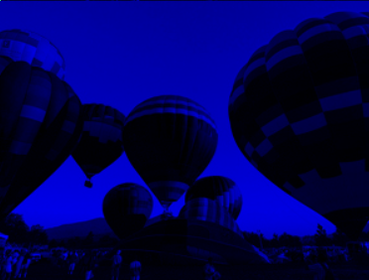
Colour spaces RGB
RGB
R
G
B

Slide 30
Colour spaces HSV / HSL
Primaries: Hue - Saturation – Value
Or: Hue – Saturation – Lightness
Colour space related to subjective description of colours
Value
Blue
Cyan
Magenta
White
Green
Red
Yellow
Hue
Black
Saturation

Slide 31
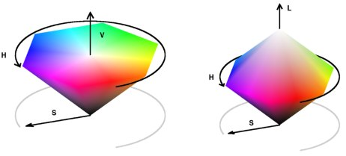
Colour spaces HSV / HSL
Conic representation of the HSV and HSL colour spaces
Source: https://uk.mathworks.com/matlabcentral/fileexchange/28790-colorspace-transformations/content/colorspace/colorspace.html

Slide 32
Colour spaces CMY(K)
Primaries: Cyan - Magenta – Yellow
Used in printing technology
Complement of RGB
BlacK

Slide 33
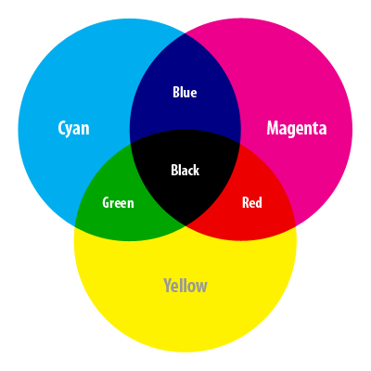
Colour spaces CMY(K)
Mixing is subtractive
Image source: http://www.netsourceinc.com/blog/quick-color-guide

Slide 34
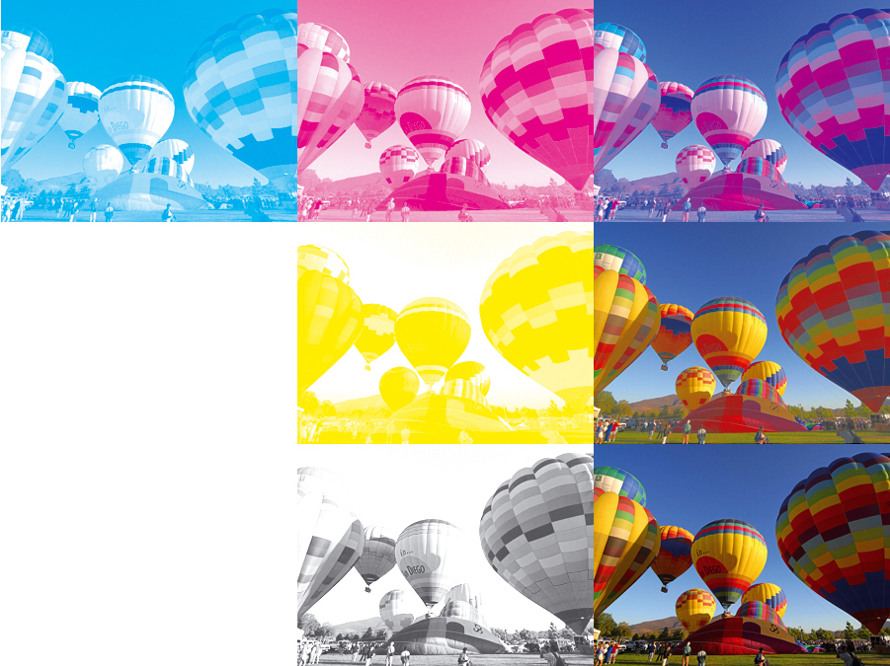
Colour spaces CMY(K)
C
M
C+M
Y
C+M+Y
K
C+M+Y+K

Slide 35
Colour spaces CIE XYZ
CIE: Commission Internationale de l'Eclairage
Primaries: X, Y, Z
Based on colour perception by humans
Device independent
The most common representation of the CIE XYZ space is the CIE chromacity diagram

Slide 36
Colour spaces CIE XYZ
Wavelengths on the periphery
G
Chromacity diagram
R
Gamut
B

Slide 37
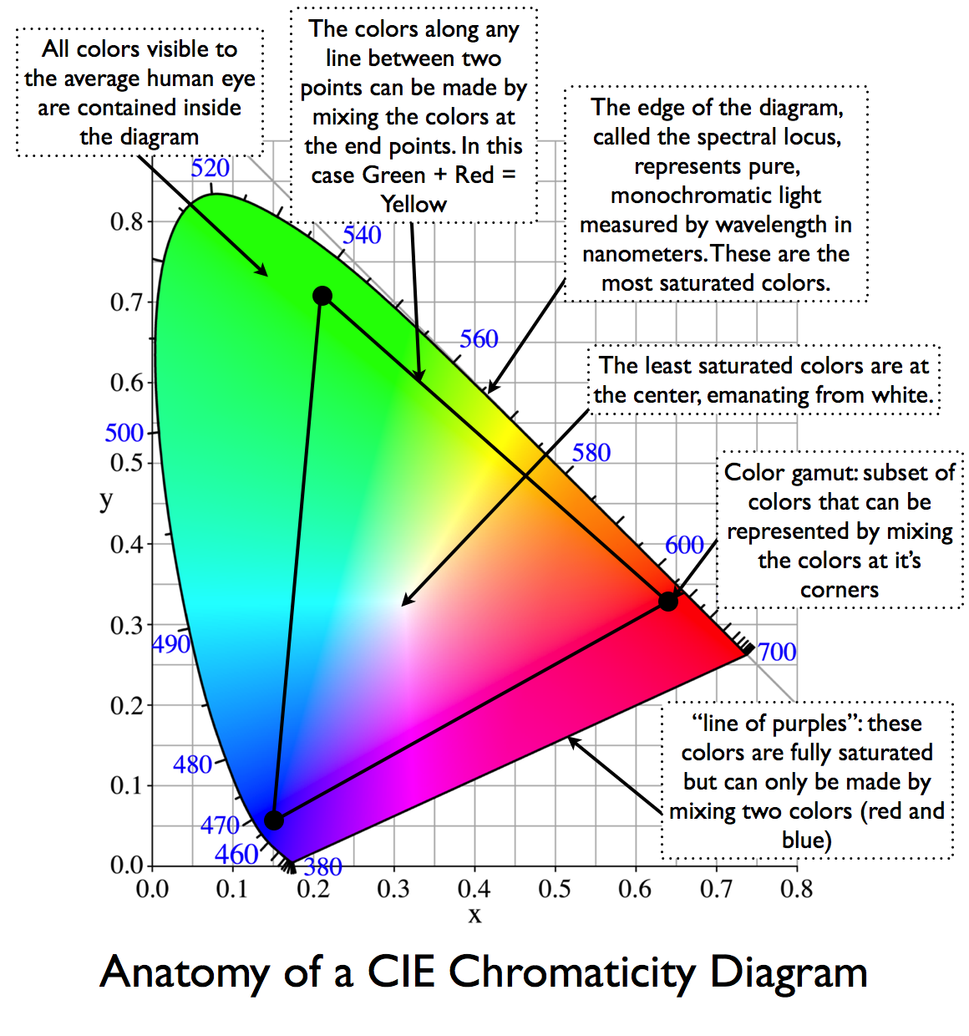
Chromacity diagram
Source: https://dot-color.com/tag/chromaticity-diagram/

Slide 38
Colour spaces
Colour picker experiment

Slide 39


Slide 40


Slide 41
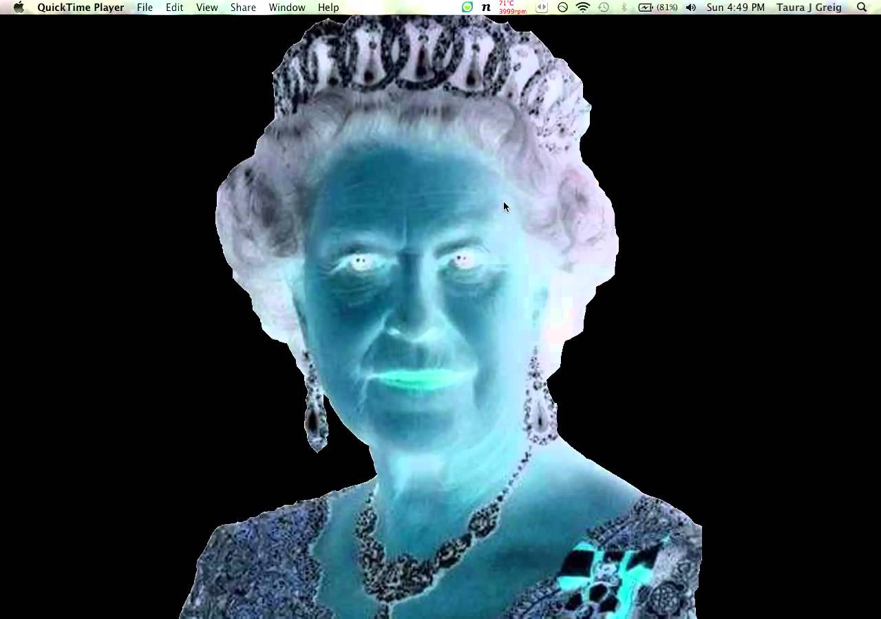

Slide 42
Afterimage illusion Complementary colours

Slide 43
In this lecture we have covered:
Colours and their origins
Physical underpinnings
Human visual perception
Colour images
Image acquisition
Colour spaces

Slide 44
Next lecture
Digital representation of colour images
Colour mixing (vector arithmetics)
Pixel arrays
Colour models

Slide 45
Further reading and experimentation
Bayer filter: http://www.cambridgeincolour.com/tutorials/camera-sensors.htm
https://en.wikipedia.org/wiki/Demosaicing
Light and colour tutorial:
http://micro.magnet.fsu.edu/primer/lightandcolor/index.html
Additive colours: http://micro.magnet.fsu.edu/primer/java/primarycolors/additiveprimaries/index.html
Subtractive colours: http://micro.magnet.fsu.edu/primer/java/primarycolors/subtractiveprimaries/index.html
Colour separation: http://micro.magnet.fsu.edu/primer/java/primarycolors/colorseparation/index.html
Afterimage illusion: https://en.wikipedia.org/wiki/Afterimage

